Slide 1
y
(x₂,y₂)
θ₁
L₁
(x₁,y₁)
L₀
θ₀
x

Slide 2
y
(x₂,y₂)
L₁
L
α
β
L₀
θ₀
x

Slide 3
y
(x₂,y₂)
L₁
L
θ₁
ζ
L₀
x

Slide 4
a₂
a₄
z₂
y₂
x₂
z₁
a₃
y₁
x₁
a₁
z₀
θ₁
y₀
x₀
θ₀

Slide 5
x₂
y₂
COM₄
COM₃
θ₁
y₁
L₁
x₁
COM₂
COM₁
y₀
θ₀
x₀
L₀

Slide 6


x₂
y₂
$\frac{1}{2}$L₁
y_{β}
x_{β}
θ₁
$\frac{1}{2}$L₀
y₁
L₁
x₁
x_{α}
y₀
θ₀
x₀
L₀

Slide 7
(x₂,y₂)
(x₁,y₁)

Slide 8
Motor Shaft
Positions (rad)
Desired
Global
Positions
x_{d},y_{d}
Inverse
Kinematics
θ_{0d},θ_{1d}
θ_{0e},θ_{1e}
C
u₀,u₁
Plant
+
-
θ_{0A},θ_{1A}
Joint
Angle
Sensors

Slide 9
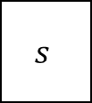
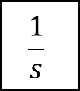
θ_{0e},θ_{1e}
PID Joint
Position
Controllers
u₀,u₁
=
Kp
Proportional
θ_{0e},θ_{1e}
$$\frac{1}{s}$$
Ki
Integral
+
u₀,u₁
+
+
$$s$$
Kd
Derivative

Slide 10
F_{ext}
Desired Position
Desired Position
Due to F_{ext}
m
k
c

Slide 11
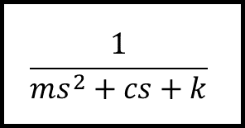
Admittance filter
$$\frac{1}{{ms}^{2}+cs+k}$$
F_{ext}
Position
Demand
(P_{D})
Desired
Position
(P_{T})
+
Position
Controller
Plant
+
-
Actual position (P_{A})

Slide 12
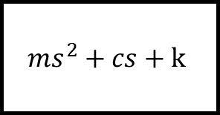
Impedance filter
$${ms}^{2}+cs+k$$
P_{ext}
Force
Demand
(F_{D})
Desired
Force
(F_{T})
+
Force
Controller
Plant
+
-
Actual Force (F_{A})

Slide 13
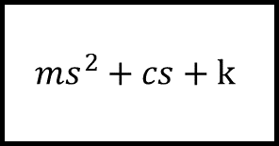
Impedance filter
$${ms}^{2}+cs+k$$
P_{ext}
Force
Demand
+
Force
Controller
Plant
Desired
Force
+
-
Actual Force

Slide 14
High Level Controller
Task Encoding
Low Level Controller
Hardware
Work Object
External Environment

Slide 15
End Effector
Desired Path
Geometric Calculation
k_{imp}
System Model
PI Controller
System
F_{a}
Δr
F_{d}
i_{d}
i_{e}
+
-
i
Joint angles

Slide 16
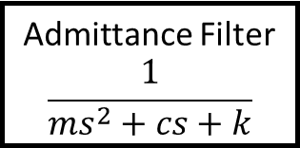
x_{p}
y_{p}
x_{d}
y_{d}
θ_{0d}
θ_{1d}
θ_{0e}
θ_{1e}
u₀
u₁
Motor Shaft
Position Output
Desired
Global
Positions
Inverse
Kinematics
PID Joint
Position
Controllers
Plant
+
+
+
-
Force Output
θ_{0A}
θ_{1A}
Joint
Angle
Sensors
x_{i}
y_{i}
θ_{0A}, θ_{1A}
Forward Kinematics
x_{A}, y_{A}
F_{x}
F_{y}
Admittance Filter
$$\frac{1}{{ms}^{2}+cs+k}$$
End Effector Force Sensor (and force resolution)

Slide 17
High Level Controller
Task Encoding/Trajectory Generation
Low Level Controller

Slide 18
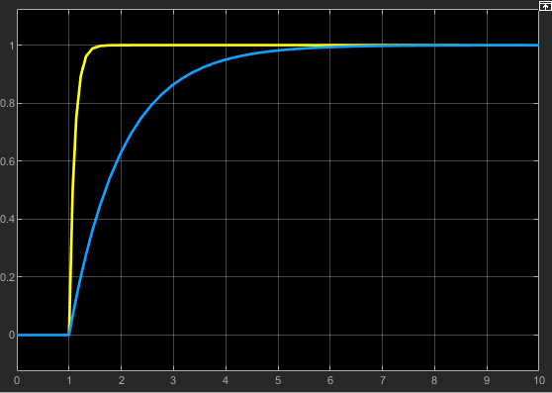

Displacement (m)
k = 10 N/m, c = 1 Ns/m
k = 10 N/m, c = 10 Ns/m
Time (s)

Slide 19
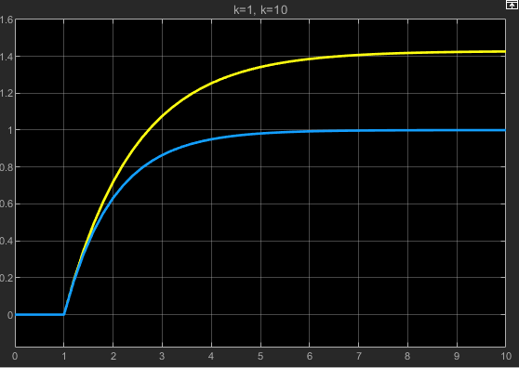
Displacement (m)
k = 7 N/m, c = 10 Ns/m
k = 10 N/m, c = 10 Ns/m
Time (s)

Slide 20
6 bits
10 bits
10 bits
10 bits
10 bits
Start Frame
Sensor 1 Data
Sensor 2 Data
Sensor 3 Data
Sensor 4 Data

Slide 21
myRIO
Arduino
Hall Effects Sensor 1
serialTxRx()
checkFrame()
disassembleFrame()
checkData()
fwdNN()
readSensors()
filter()
buildFrame()
serialRxTx()
Hall Effects Sensor 2
Serial
Hall Effects Sensor 3
Hall Effects Sensor 4

Slide 22
Side View
Spring Balance Force Meter
Test Piece
Loading point
movement
Loading point
Rexroth Base
Top View
Test Piece Rotation angle
Spring Balance Force Meter
Test Piece
Loading point
movement
Rexroth Base
Loading point

Slide 23
Input layer
Hidden
Layer 1
Hidden
Layer 2
Output
Layer
Raw 1
Raw 2
.
.
.
.
.
.
Fx
Raw 3
Fy
Raw 4
N=4
N=20
N=10
N=2

